Slide 1
41183 PRIVACY PRESERVING
Lecture 6. Personalized Privacy

Slide 2
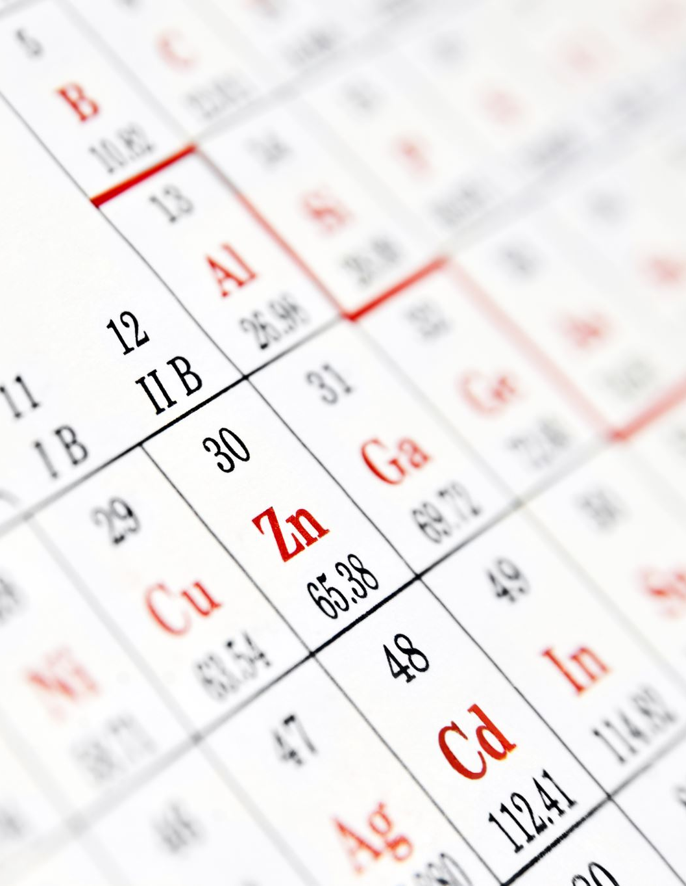
Assignment 1
Due on Friday, September 11, 2026.
2- 3 members in a group
Only one submission to Canvas
Please include the membership information (student number, name) on the cover page.
In general, the members will obtain the same marks if there is no complaints.

Slide 3

Outline
Background
Privacy measurement
Personalized privacy implementation

Slide 4
Background
The mainstream privacy protection mechanisms
Encryption
Differential privacy
Common assumption: all users’ privacy expectations are the same (a homogeneous setting)

Slide 5
Background
In practice, people’s expectation for privacy protection are quite different
Culture
Religion
Gender
Timing
…
Therefore, personalized (customized) privacy protection is highly demanded in practice.

Slide 6
Background
For personalized privacy protection, we have to have a measure of
Individual privacy expectation (independent)
Relative privacy expectation (dependent)
…
Therefore, we need measurements on privacy in various fashions.

Slide 7
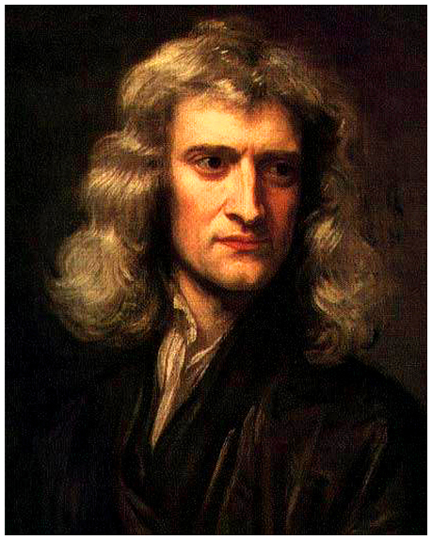
Privacy measurement
Independent measurement
Given an individual, what is the privacy expectation?
It is hard to measure
There is no independent (direct) measurement so far
“I can calculate the movement of stars, but cannot measure the madness of men”

Slide 8
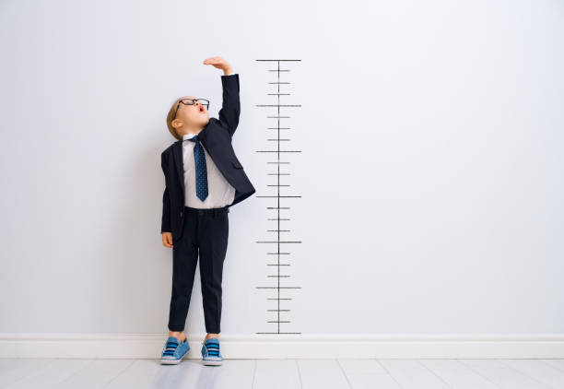
Privacy measurement
Independent measurement
The solution is in cross disciplinary methodologies
Psychology + Computer Science
Social Science + Computer Science
…

Slide 9
Privacy measurement
Dependent (relative) measurement
Given a benchmark, what is the relative privacy expectation compared to the benchmark?
E.g., females have a higher privacy expectation compared with males in a class
Available measures
k-anonymity
- information theoretical measures
Information leakage
Entropy variation
Social distance

Slide 10
Personalized Privacy Preserving
Application scenarios (Social networks, e.g., facebook)
Alice plans to post her dinner photos on social networks, viewers will see the photos with exact location information without any protection, e.g., UTS, Sydney, NSW
However, Alice wants to reveal the location information against the closeness between she and the viewers
UTS, Sydney, NSW for close friends (e.g., Bella)
Sydney, NSW for friends (e.g., Chris)
NSW for others (e.g., David)
…

Slide 11
Personalized Privacy Preserving
Measure the social distance between the pair (information publisher and the viewer)
Social distance (sd) measurement
Alice - Bella (AB)
Alice – Chris (AC)
Alice – David (AD)
Methods:
interactions between the pair
Sentiment analysis (AI)

Slide 12
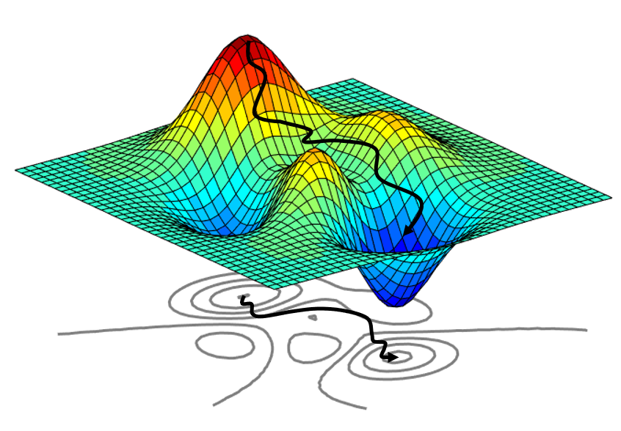
Personalized Privacy Preserving
Personalized privacy implementation
social distance + differential privacy
Social distance -> privacy budget
How to measure social distance ?
Counting
Sentiment analysis
Group distance
Features of working space (flat or curved ?)

Slide 13
Personalized Privacy Preserving
Using cryptography methods
- customize content, then encrypt – deliver – decrypt
The challenges
- key management
- big challenge for large number of pairs
- efficiency of encryption and decryption
-- asymmetric encryption for key management
-- symmetric encryption for content transportation

Slide 14
Personalized Privacy Preserving
Using ABE (attribute based encryption)
- a small number of receivers sharing a decryption key based on their shared features.
The challenges
- scalability of key management

Slide 15

Thank you & Questions http://www.uts.edu.au/syu email: shui.yu@uts.edu.au

